Slide 1

Learning outcome 1
Marketing Processes and Planning

Slide 2
Learning outcome
Role of marketing and how it interrelates with other business units of an organisation

Slide 3



Key Learning
The marketing concept
The role of marketing
Interrelationships of business units

Slide 4
The marketing concept
The marketing concept is a business philosophy that focuses on meeting the needs and wants of customers while also achieving the goals of the organization. The marketing concept recognizes that the key to business success is not just producing products or services, but also understanding the needs and wants of the target market and creating value for customers.
.

Slide 5
Main components of marketing concept
3. Customer satisfaction
1. Customer orientation
The company must strive to meet or exceed customer expectations, leading to customer loyalty and repeat business
The company must focus on the needs and wants of its target customers.
2. Integrated marketing
All aspects of the marketing mix (product, price, promotion, and place) must work together to deliver value to customers

Slide 6
The development of the marketing concept, including current and future trends
The marketing concept has evolved over time to keep up with changes in consumer behaviour , market conditions, and technological advancements It has its roots in the Industrial Revolution and has gone through several stages of development

Slide 7
key stages in the development of the marketing concept
20th century
1950s and 1960s
Marketing orientation
businesses began to recognize the importance of understanding customer needs and wants. The marketing orientation approach meant that companies would focus on identifying customer needs and then creating products that would meet those needs.
Production orientation
In the early days of the Industrial Revolution, businesses focused on producing as many goods as possible to meet the growing demand.

Slide 8
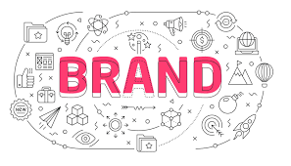
The concepts of brand positioning and management
Brand positioning is the process of creating a distinct perception in the minds of consumers about a brand's unique attributes and benefits compared to its competitors. It involves determining the most effective way to differentiate a brand from its competitors and communicating that differentiation to target customers. The goal of brand positioning is to create a compelling and memorable impression that resonates with customers and helps build brand loyalty.

Slide 9
Implementing process to support corporate reputation.
Define Your Corporate Reputation Goals
Before you start implementing any process, it's important to define your goals. What do you want to achieve through your corporate reputation process? Do you want to improve your company's image, increase customer loyalty, or attract new customers? Whatever your goals may be, make sure they are clearly defined.
Conduct a Reputation Audit
Conduct a thorough audit of your current corporate reputation. Identify areas where your reputation needs improvement and areas where you are already performing well. Gather data from various sources including social media, customer feedback, media coverage, and employee surveys.

Slide 10

The role of marketing
Marketing plays a critical role in helping organizations promote and sell their products or services to customers. The primary objective of marketing is to create customer value by understanding their needs and wants, and then developing products and services that meet those needs.

Slide 11
The structure and operations of marketing departments
Market research
Marketing planning
Market research is the process of gathering, analyzing, and interpreting information about a particular market or industry.
Based on the insights from market research, marketing departments develop marketing plans that outline the objectives, strategies, tactics, and budgets for various marketing campaigns.
Advertising
Advertising is a marketing communication strategy used by businesses and organizations to promote their products, services, or ideas to their target audience. .
Brand management
Marketing departments are responsible for managing the brand identity of the business. This includes developing the brand strategy, creating brand guidelines, and ensuring that all marketing communications align with the brand's identity.
Direct marketing
Direct marketing is a form of marketing in which businesses and organizations communicate directly with their target audience to promote their products, services, or ideas.
Sales enablement
Marketing departments work closely with the sales team to create sales materials, such as product brochures

Slide 12
Responsivilites required in marketing
Marketing is a broad field with various roles and responsibilities, each requiring a unique set of competencies. Here are some of the common roles in marketing and their respective responsibilities
Marketing and Communications Officer: Responsibilities:
Developing and implementing marketing and communication plans
Creating and executing content marketing strategies
Developing and managing social media campaigns
Developing and executing email marketing campaigns
Managing public relations and media outreach
Building and managing relationships with clients and stakeholders
Digital Marketer: Responsibilities:
Developing and implementing digital marketing strategies
Conducting market research and analyzing customer behaviour
Creating and managing social media campaigns
Developing and executing email marketing campaigns
Managing pay-per-click (PPC) advertising campaigns
Developing and managing search engine optimization (SEO) strategies
Marketing Executive: Responsibilities:
Developing marketing strategies and campaigns
Analyzing market trends and customer behaviour
Conducting market research
Managing budgets and resources
Developing and executing promotional activities
Building and managing relationships with clients and stakeholders
Monitoring and reporting on campaign performance

Slide 13
Competencies required in marketing
Marketing is a broad field with various roles and responsibilities, each requiring a unique set of competencies. Here are some of the common roles in marketing and their respective competencies:
Marketing Executive:
Competencies:
Strong analytical and problem-solving skills
Excellent communication and interpersonal skills
Creativity and innovation
Strategic thinking and planning abilities
Attention to detail
Leadership and project management skills
Marketing and Communications Officer:
Competencies:
Excellent written and verbal communication skills
Strong organizational and planning skills
Creativity and innovation
Proficiency in digital marketing tools and platforms
Strong attention to detail
Collaboration and teamwork
Digital Marketer:
Competencies:
Strong analytical and problem-solving skills
Proficiency in digital marketing tools and platforms
Knowledge of web analytics and data analysis
Strong attention to detail
Creativity and innovation
Collaboration and teamwork

Slide 14
A market overview is an analysis of a particular market, including its size, growth potential, trends, and competition.
Overview of marketing processes that include market research, data analysis, strategic planning and conducting marketing campaigns

Slide 15
Market research
Market research is the process of gathering and analyzing information about customers, competitors, and market trends. It helps businesses understand customer needs, preferences, and behaviour to develop products and services that meet those needs. Market research methods include surveys, interviews, focus groups, and observational studies.

Slide 16
Data Analysis
Data analysis is an essential part of marketing processes as it allows marketers to gain insights into customer behaviour and preferences, evaluate the effectiveness of marketing campaigns, and make data-driven decisions to improve marketing efforts.
1
After collecting data, businesses need to analyze it to make informed decisions
2
Data analysis involves sorting, organizing, and interpreting data to extract meaningful insights.
3
Data analysis helps businesses understand customer behaviour, identify trends, and predict future outcomes.

Slide 17
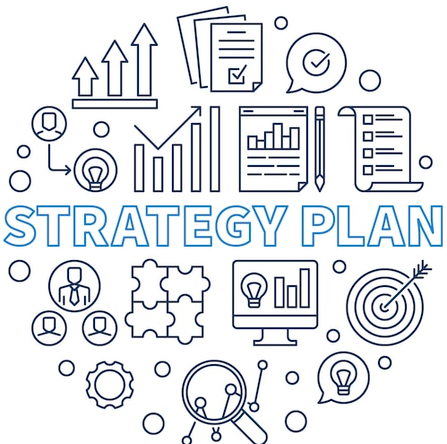
Strategic Planning
Strategic planning involves developing a long-term plan for achieving business goals. It involves analyzing market research and data to identify opportunities and threats, defining target markets, setting marketing objectives, and developing marketing strategies to achieve those objectives. Strategic planning provides a roadmap for businesses to follow and helps them stay on track.

Slide 18
Conducting Marketing Campaigns
Once the marketing plan is in place, businesses need to execute it by launching marketing campaigns. Marketing campaigns involve communicating the value of products or services to target customers through various channels such as advertising, social media, email marketing, and events.
"Just Do It" campaign is one of the most iconic and successful marketing campaigns of all time. The campaign was launched in 1988 by Nike's ad agency

Slide 19
The role of digital marketing as a core driver of marketing strategy
In today's digital age, digital marketing has become an essential part of any marketing strategy. It has transformed the way companies reach and engage with their target audiences, and has become a core driver of marketing strategy in many industries.
Here are some of the key reasons why digital marketing is so important:
Cost-effective: Compared to traditional marketing methods such as print advertising, digital marketing is often more cost-effective. With a smaller budget, companies can reach a larger audience through various digital channels such as social media, email marketing, and search engine advertising.
Targeted: Digital marketing allows companies to target specific audiences based on demographic, geographic, and psychographic factors. This allows companies to deliver more personalized and relevant messages to their target audience, increasing the likelihood of engagement and conversion.
Measurable: Digital marketing campaigns can be tracked and measured in real-time, allowing companies to quickly adjust their strategies based on performance data. This level of visibility and control allows companies to optimize their campaigns for better results.

Slide 20

The role of digital marketing including Search Engine Optimisation (SEO)
Digital marketing refers to the use of digital channels, such as search engines, social media, email, and websites, to promote a brand, product, or service. Search Engine Optimization (SEO) is a critical component of digital marketing, which focuses on improving the visibility and ranking of a website in search engine results pages (SERPs).
The primary goal of SEO is to optimize a website's content, structure, and technical elements to make it more appealing to search engines and, ultimately, to users. This involves researching and selecting relevant keywords, creating high-quality content that aligns with user intent and the search engine algorithm, building high-quality backlinks, and improving the website's technical elements such as page load speed, mobile-friendliness, and security.
SEO is important for digital marketing because it helps businesses attract more organic traffic to their websites, increase their brand visibility, and ultimately drive conversions. By optimizing their website for search engines, businesses can improve their chances of being found by potential customers who are searching for products or services related to their business.

Slide 21

The role of digital marketing by using web analytics
The role of digital marketing is to promote a brand, product, or service through digital channels, such as search engines, social media, email, and websites. It involves using various techniques, strategies, and tools to reach a target audience and achieve specific marketing goals.
Web analytics is a critical tool in digital marketing that helps businesses track and analyze website traffic, user behaviour, and conversion rates. It provides insights into how visitors interact with a website, what pages they visit, how long they stay, and whether they convert into customers or not

Slide 22

Web analytics can help businesses in many ways, including:
Understanding their target audience: By analyzing website data, businesses can learn more about their target audience, such as their demographics, interests, and behaviour. This information can help them create more targeted and effective digital marketing campaigns.
Improving website performance: Web analytics can help businesses identify issues with their website, such as slow page load times or high bounce rates. By addressing these issues, they can improve the user experience and increase the chances of conversion.
Measuring marketing ROI: Web analytics can help businesses track the performance of their digital marketing campaigns, such as the number of leads generated, conversion rates, and revenue generated. This information can help them evaluate the effectiveness of their marketing efforts and make data-driven decisions

Slide 23

The role of digital marketing
Digital marketing encompasses various strategies and tactics, including social media marketing, mobile marketing, and pay-per-click (PPC) marketing. Here's a brief overview of each and their role in digital marketing:
1.Social media marketing:
Social media marketing involves using social media platforms, such as Facebook, Instagram, Twitter, and LinkedIn, to promote a brand, product, or service. The primary goal of social media marketing is to engage with the target audience, build brand awareness, and drive website traffic.

Slide 24


2.Mobile marketing:
Mobile marketing involves targeting users on mobile devices, such as smartphones and tablets, with mobile-optimized campaigns. This includes mobile apps, mobile-responsive websites, SMS (short message service) marketing, and push notifications. The primary goal of mobile marketing is to reach consumers on the go, where they are most likely to make purchases.
3.Pay-per-click marketing:
Pay-per-click marketing involves paying for clicks on ads that appear on search engine results pages (SERPs) and other websites. This includes Google Ads, Bing Ads, and social media advertising platforms, such as Facebook Ads and LinkedIn Ads. The primary goal of PPC marketing is to drive website traffic, generate leads, and increase sales.

Slide 25
The interrelationships of business units

Slide 26
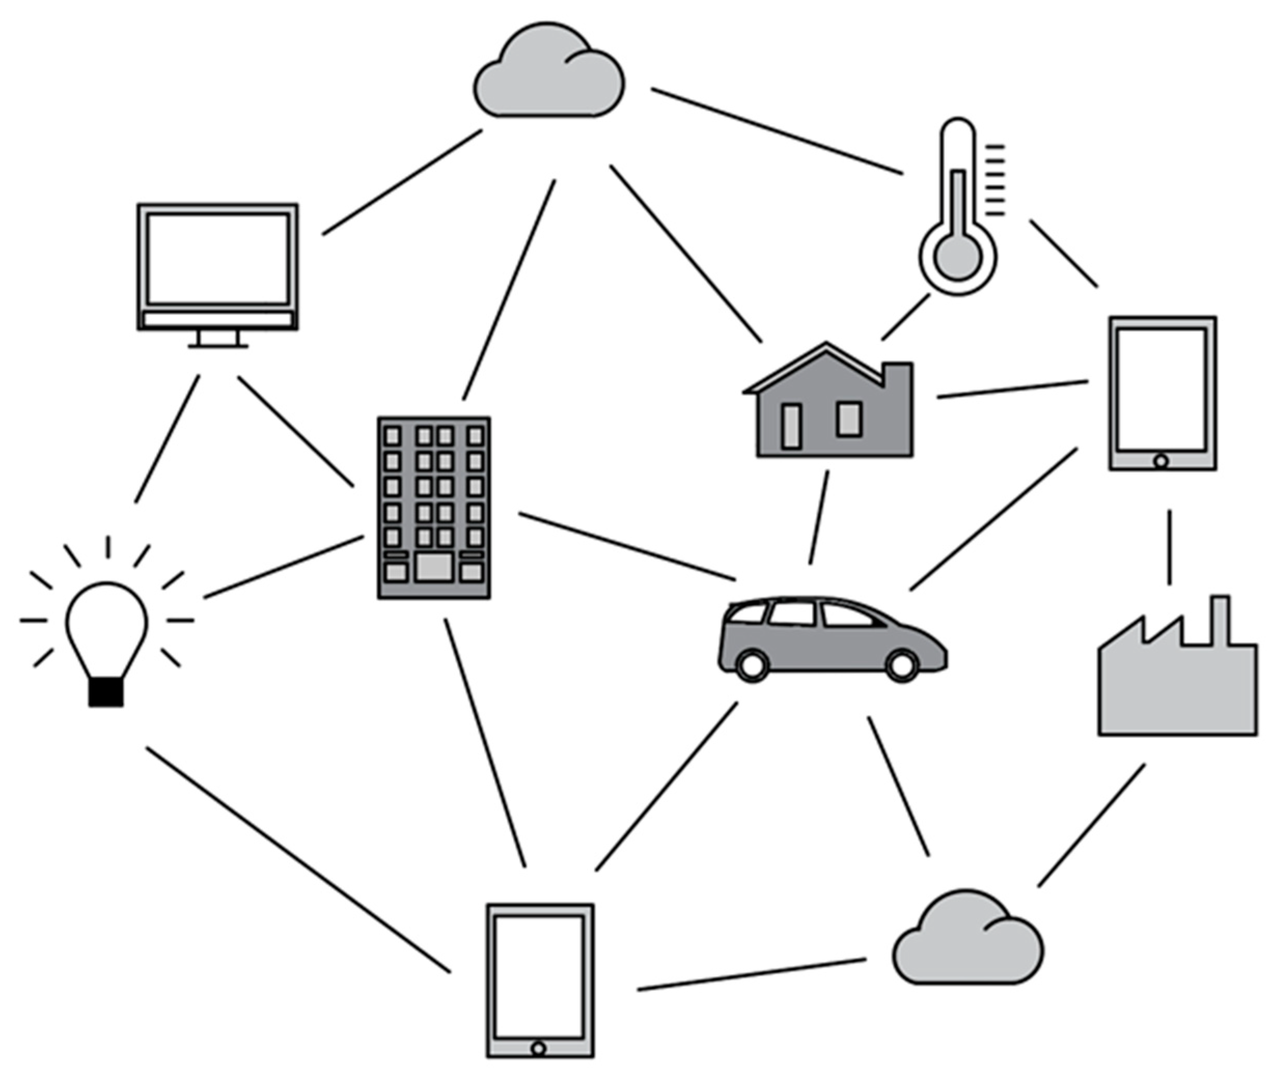
The interrelationships of business units
The interrelationships of business units refer to the ways in which different departments or divisions within an organization collaborate and work together to achieve common goals. These interrelationships are crucial for the success of the organization, as they help to ensure that resources are used efficiently, communication is effective, and everyone is working towards the same objectives

Slide 27
Ways in which business units can be interrelated
01
Horizontal relationships
This refers to the relationships between departments or units that are at the same level within the organization.
Diagonal relationships
02
This refers to the relationships between departments or units that are not directly related to each other but still have an impact on each other's activities.
03
Vertical relationships
This refers to the relationships between departments or units that are at different levels within the organization.
Shared services relationships
04
This refers to the relationships between departments or units that share common resources or services.

Slide 28

The different roles of business units
In a typical organization, different business units perform various roles that contribute to the overall success of the company. Here are some common business units and their roles:
Sales: The sales team is responsible for generating revenue by selling products or services to customers. They typically develop relationships with customers, identify their needs, and offer solutions that meet those needs.
Marketing: The marketing team is responsible for promoting the company's brand, products, or services. They use various strategies, such as advertising, public relations, and content marketing, to reach potential customers and generate leads.
3.Operations: The operations team is responsible for ensuring that the company's products or services are delivered efficiently and effectively. They manage the production process, supply chain, and logistics to ensure that products or services are delivered on time and at a high level of quality.
4.Finance: The finance team is responsible for managing the company's financial resources. They handle financial planning, budgeting, forecasting, and accounting to ensure that the company is financially healthy and sustainable.
5.Human Resources: The human resources (HR) team is responsible for managing the company's workforce. They handle tasks such as recruitment, training, performance management, and employees

Slide 29
The interrelationships between these functional areas and marketing
Marketing is closely intertwined with the other functional areas of a business, and the success of marketing efforts often depends on collaboration and coordination with these areas. Here are some examples of the interrelationships between marketing and other functional areas
Sales: Marketing and sales are closely connected because they both focus on generating revenue for the company. Marketing efforts, such as advertising and promotions, help generate leads and create interest in products or services, while the sales team works to convert those leads into customers.
Operations: Marketing needs to work closely with operations to ensure that the company's products or services are delivered efficiently and effectively. For example, marketing may need to communicate changes in product features or pricing to the operations team, who can then make the necessary adjustments to production or logistics
Finance: The finance team provides critical support to marketing by helping to create budgets, tracking marketing expenses, and measuring the ROI of marketing efforts. Marketing and finance must work together to ensure that marketing expenses align with the company's financial goals and that marketing efforts generate a positive return on investment.

Slide 30
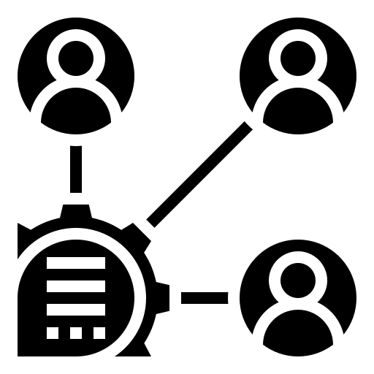
The principles of stakeholder management and customer relationship management (CRM) to facilitate effective cross-functional relationships internally.
Stakeholder management and customer relationship management (CRM) are both essential principles that can facilitate effective cross-functional relationships internally. Here's how:
Stakeholder Management: Stakeholder management involves identifying, analyzing, and prioritizing stakeholders and their needs and interests. This includes both internal stakeholders (such as employees and managers) and external stakeholders (such as customers, suppliers, and shareholders).
By prioritizing stakeholder needs, businesses can develop cross-functional relationships that align with the company's overall goals and objectives. For example, if stakeholders prioritize customer satisfaction, cross-functional teams can work together to develop products and services that meet those needs, resulting in higher customer retention rates and revenue growth.

Slide 31
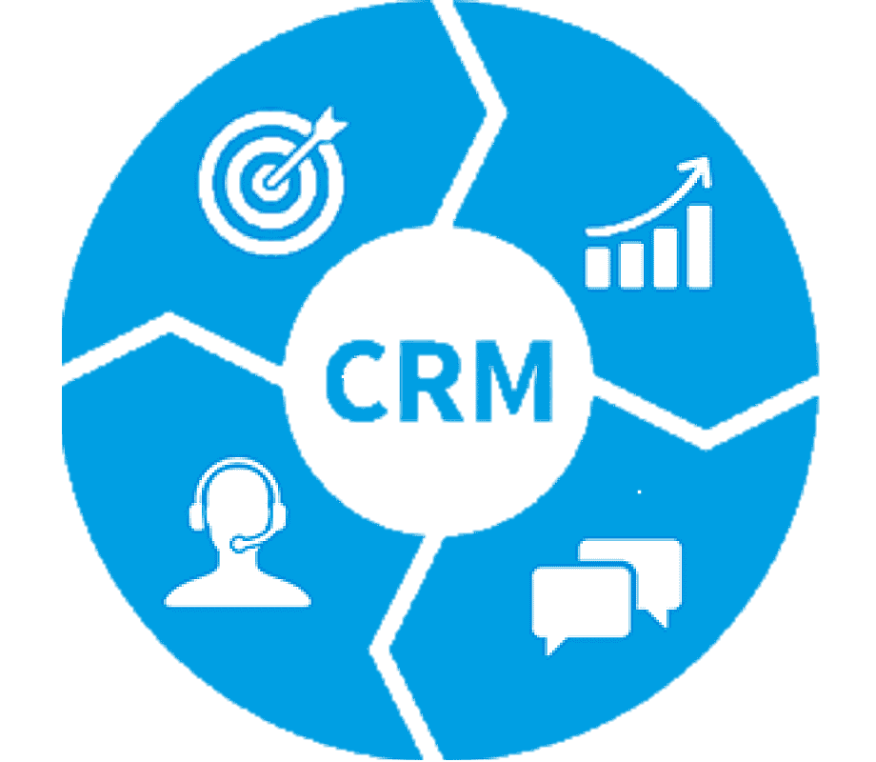
Customer Relationship Management (CRM):
CRM is a strategy that focuses on building and maintaining strong relationships with customers. It involves using data and analytics to understand customer preferences and behaviours, and then tailoring marketing and sales efforts to meet those needs.
By implementing a CRM
strategy, businesses can create cross-functional relationships between marketing, sales, and customer service teams. This alignment can help ensure that the company is meeting customer needs and expectations at every touchpoint, resulting in improved customer loyalty and retention.
Overall, both stakeholder management and CRM are essential principles that can facilitate effective cross-functional relationships internally. By prioritizing stakeholder needs and focusing on building strong customer relationships, businesses can create a cohesive, customer-centric approach that drives growth and success

Slide 32
Summary
Marketing processes and planning refer to the strategic activities involved in identifying, anticipating, and satisfying customer needs profitably.
Understanding the customer and their needs through market research and analysis.
Developing a marketing strategy that aligns with the organization's overall goals and objectives.
Creating a marketing plan that outlines the specific tactics and activities that will be used to execute the marketing strategy.
Implementing the marketing plan by executing the tactics and activities outlined in the plan.
Evaluating the effectiveness of the marketing plan and making adjustments as needed.
Marketing planning involves identifying the target market, understanding customer needs and behaviours, developing a value proposition that sets the organization apart from its competitors, and creating a marketing mix that includes product, price, promotion, and place.

Slide 33
THANK YOU

